Slide 1

Installation and Initial Start Up
by Laco Remias, Service Engineer, Aftersales & Service
Worldwide Manufacturer of PSA Generators

Slide 2

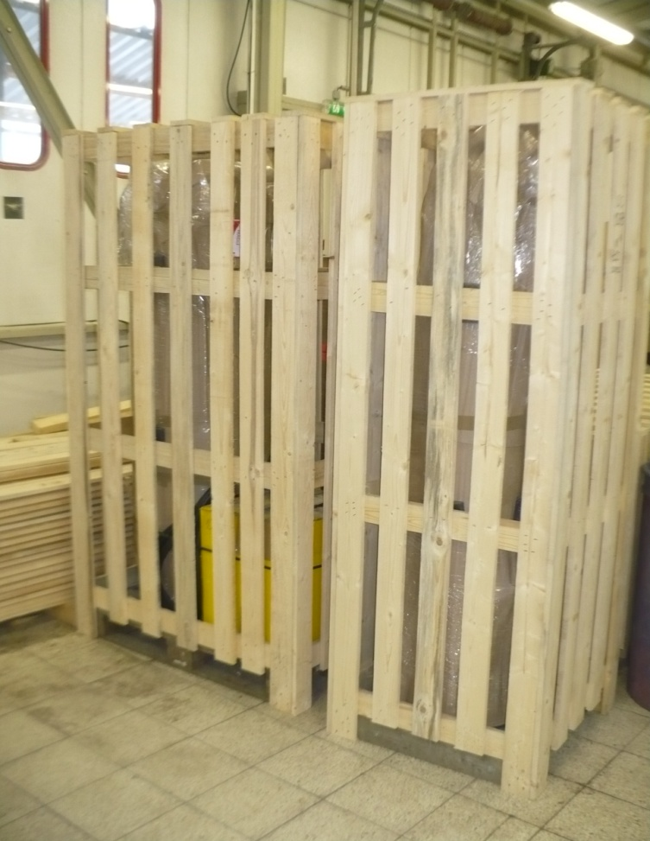
Unpacking
You receive your Oxymat generator packed in a paperboard, covered with the plastic foil, standing on a wooden pallet.
Base plate is fastened to the pallet for the stability during transport.
Individual pallets are packed in a wooden crate.
During the unpacking be careful not to harm or destroy the components inside
Important !!!
Before signing of shipping document, please make a sure that all received components are not harmed or damaged.
If you find some damage, please make a note in shipping document, take a picture of it and contact Oxymat representative
Worldwide Manufacturer of PSA Generators

Slide 3
Before installation
Consider the location:
space available – operating, service
FAD air supply
power supply (Voltage, Frequency)
cooling water connections
Exhoust duct ... etc. for individual devices
!!! For safe installation of compressor, dryer or other equipment follow the instructions in manuals concerned for the equipment.
Your generator must be located on:
levelled surface
in a well-ventilated indoor area
exhaust gas to safe area !!!
ambient temperature 5°C to 45°C
!!! Operating of generator in an area below 5°C or above 45°C will cause damage not covered under the manufacturer’s warranty.
Worldwide Manufacturer of PSA Generators

Slide 4
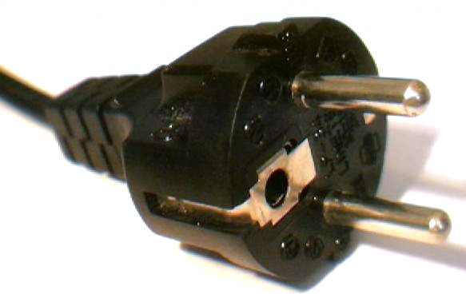
Power supply
It is recommended to use a circuit that will not be accidentally turned off, as this will cause the unit to stop cycling.
In order to prevent production stop and purity drop in case of electric power failure, a UPS (power backup) is recommended as an option.
Power connection parameters:
110-240V, 50-60 Hz, single phase
Maximum fuse on power supply 10A
Oxymat recommends to use electrical filters to protect PLC
Power should be supplied to the unit from a grounded electrical outlet with a 3-prong plug
power supply to the equipment is under the customers responsibility if not agreed otherwise
!!! Improper voltage will cause damage not covered under the manufacturer's warranty.
Worldwide Manufacturer of PSA Generators

Slide 5
Air supply (Feed air)
Compressed Air parameters:
compressed feed air supply must be less than 40°C before it reaches the PSA Generator
Pressure dew point of feed air ≤+3°C
The feed air quality must comply with ISO specification 8573-1:2001 class 1.4.1., e.g.
High feed air temperature will reduce the performance of the Oxymat Generator and will cause damage not covered under the manufacturer's warranty.
High dew point indicates a risk of water condensate in the generator system
Content of particles max. 0.1 mg/m³ at size 0.1 μm or smaller, dew point +3°C & residual water content max. 6 g/m³ and residual oil content max. 0.01 mg/m³.
Low feed air temperatures may cause freezing of components and damage not covered under the manufacturer's warranty.
Worldwide Manufacturer of PSA Generators

Slide 6
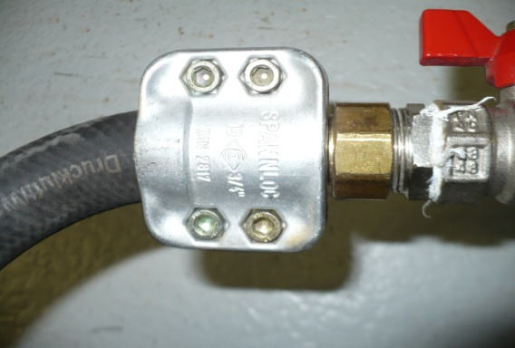
Interconnections
fixed manifold interconnections is recommended
connections with hoses must be done with high quality connection systems, e.g. clamp system or compression end fittings
consider compressor inlet and exhaust outlet piping/duct installation
After the interconnections installation always perform a proper leak test!
Hose/piping connections should be dimensioned to provide needed Air/Gas flow at a certain pressure
For proper dimensioning of the piping follow the instructions in Oxymat manual
The use of an improperly size of hose/piping will result in reduced capacity of PSA.
Worldwide Manufacturer of PSA Generators

Slide 7
Installation
Worldwide Manufacturer of PSA Generators

Slide 8
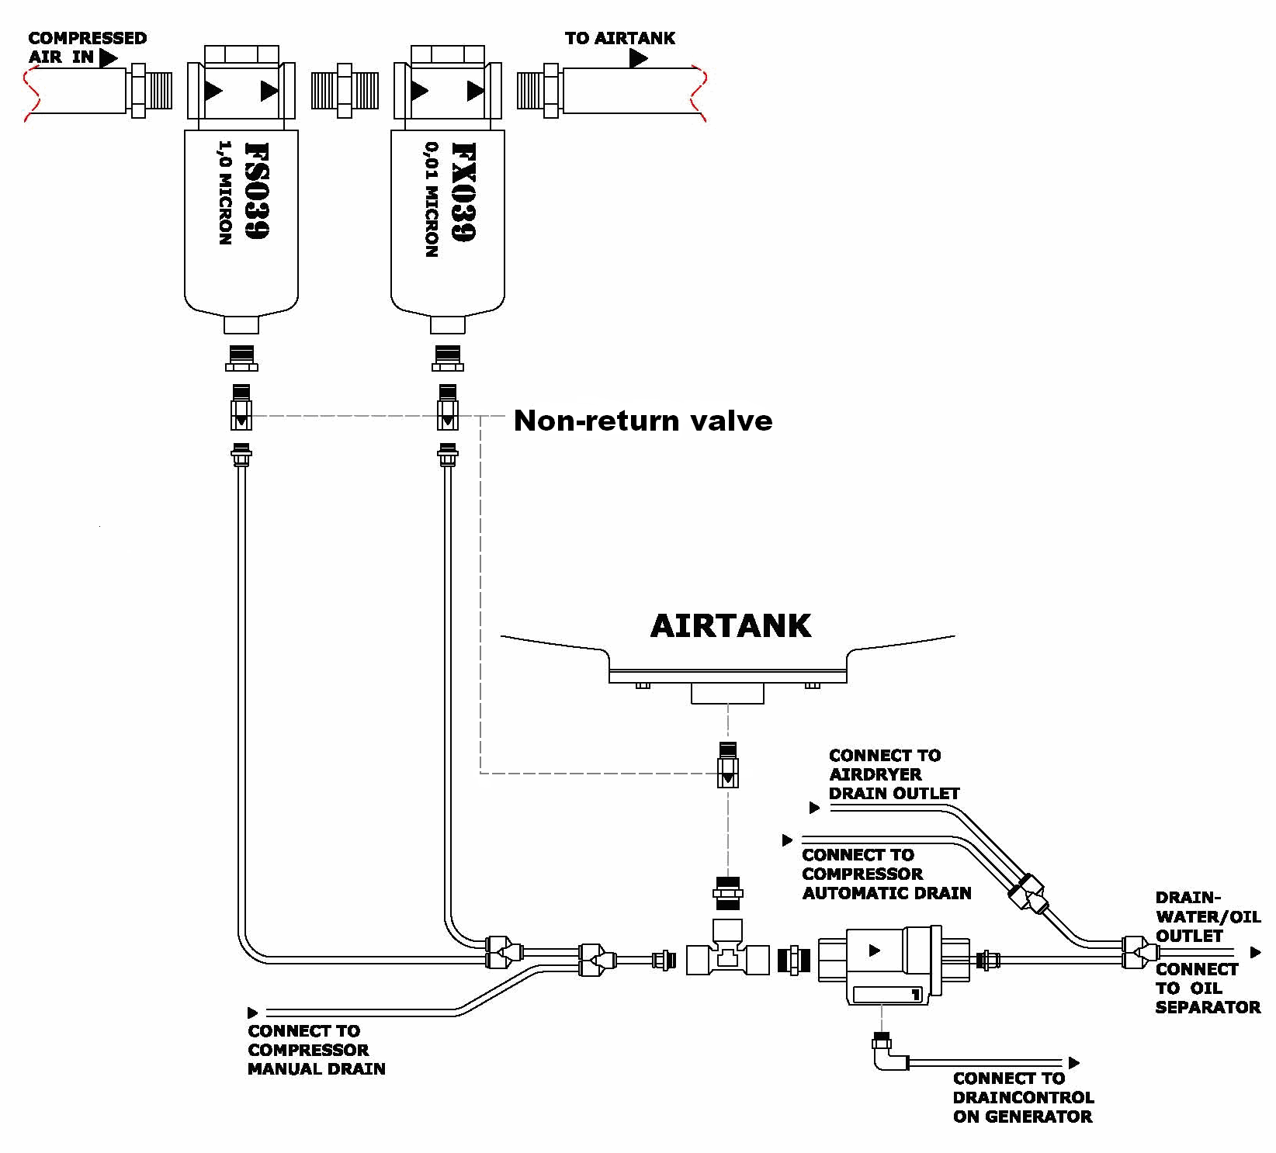
Drain system
Air Compressor and Dryer automatic draining
Air Compressor, Dryer, Filtration unit and Air tank manual draining driven from Generator PLC
Common outlet to the drainage receiver
Worldwide Manufacturer of PSA Generators

Slide 9
Modes of operation
The Oxymat Generator can operate either in Auto or Manual Mode or can be in Stand-by Mode.
In Auto Mode the generator runs in an on/off operation depending on the actual O2/N2 demand.
In Manual Mode the generator runs in a continuous, forced operation used for rising of product purity/pressure, start up or for troubleshooting.
In Stand-by Mode the generator stand still - ready for the next re-start
Panel control I - 4“ touch screen
Worldwide Manufacturer of PSA Generators

Slide 10
Start up the plant
Turn the Air dryer on, wait until you reach temperature ≤+3°C, if the dryer is stand alone. Desicant dryer - is not necessary to wait.
Start up the compressor against to open Air tank
When compressore reach the unload pressure (compressor pressure stop value), open the generator inlet valve and start generator in manual mode against open Product tank, with closed delivery valve
After you reach stable performance (purity, pressure...) open the product tank outlet and start delivery
When stable – swith to auto mode
To check the performance of the generator assembly, compare the actual performance values with those in the Design Rewiev Certificate
Worldwide Manufacturer of PSA Generators

Slide 11
Setpoints and parameters
Adjustable:
Purity alarm – flashing Alarm indication
Purity stop – purity too low, stop of operation
Pressure stop – generator go to stand-by mode due to small or no consumption
Pressure restart – generator restart after pressure drop
Purge settings - to prevent low purity product to be delivered to either the product tank or to the delivery line
!!! Process settings are locked by Level 2 password. Changing of the values will change the generator performance. Always contact Oxymat representatives in case of persisting troubles.
User settings button
Level 1password is 4021
Panel control I – purity settings
Worldwide Manufacturer of PSA Generators

Slide 12
Pressure settings
Correct Pressure set-point stop is essential for fluent generator operation, as it controls Start and Stop of generator in auto mode.
How to set up:
Run the generator in manual mode with closed product delivery valve (no consumption)
Let the generator run for at least 10 min and read the maximum pressure in the product receiver tank - Peak pressure P1
Calculate the Pressure set-point stop P2 by subtracting 0.05 from peak pressure P1. P2 = P1 - 0.05
The pressure restart set point (normal value 0.5 bar) controls when the generator restarts. P3 = P2 - 0.50
Example:
Measured peak pressure P1: 6.50 bar
Stop set point pressure P2 = P1 - 0.05 = 6.50 - 0.05 = 6.45 bar.
With hysteresis set to 0.5 bar the generator will restart when the pressure in receiver tank has decreased 0.5 bar.
Restart at P3 = P2 - 0.50 = 6.45 - 0.50 = 5.95 bar
Worldwide Manufacturer of PSA Generators

Slide 13
Shut down
Close the delivery valve on the product tank to stop the O₂/N₂ consumption. This will insure that the receiver tank is full at next startup.
The generator should be turned off in Auto mode. After you close consumption, wait until the generator stops cycling at the pressure stop value. This allows the receiver tank to fill completely with O₂/N₂ for immediate use after restart.
This also allows the unit to shutdown at the proper point in the cycle.
NOTE:
Immediate or accidental stop of operation during a cycle will result in temporary lower product purity during subsequent use.
Power turn off:
Turn off the compressor power switch
Turn off the generator power switch
Make sure that the Air tank and Product tank inlet/outlet valves are closed to keep the pressures at maximum pressure
Turn off the air dryer power switch
Worldwide Manufacturer of PSA Generators

Slide 14
Oxymat A/S
Fasanvej 18-20
DK-3200 Helsinge
Denmark
www.oxymat.com

